Slide 1
caArray Silver Compatibility Review
Juli Klemm
Eric Tavela
Maki Duncan
NCICB
February, 2008

Slide 2
Agenda
Project overview
  What is caArray
  Strengths and challenges
Domain Model
  Overall approach
  Microarray data modeling
  Imported classes
Architecture and APIs
  Architectural overview
  API description
  Remote Java API tests and Grid Service tests
Project status
  Availability
  Silver submission package

Slide 3
Project Overview: caArray
Product Description: caArray is a web and programmatically accessible array data management system. caArray supports the annotation and exchange of array data using a federated model of local installations whose results are shareable across caBIG™.
Technical strengths
  Simplified domain model and API (from caArray 1.x)
  Efficient storage and retrieval of microarray data
  Support for MAGE-TAB import
  Focus on usability
Targeted user community
  Bench scientists performing microarray data collection and annotation
  Microarray core facility scientists
  Bioinformatics and data management coordinators
  Multi-institutional data coordinating center informaticists

Slide 4
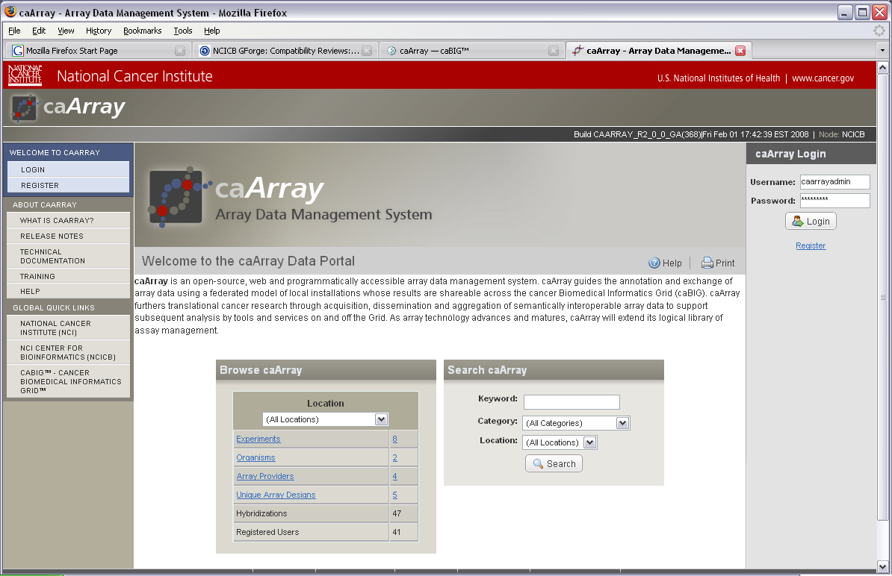
Project Overview: caArray

Slide 5
Project Overview: User Interface
User Interface:
  Browse and Search through the repository for Experiments of interest. The search mechanisms lead to actionable results that are clear to the end user and incorporate their specific rights for the experiments.
  Submit and access array data and annotations based on a role-based workflow designed to support collaboration between Principle Investigators, Lab Administrators, Scientists and Statisticians. The end-to-end states of an experiment are: Draft, In Progress, and Public.
  Upload, validate, and import single files or a set of zipped files. The workflow allows for the effort to be spread over time and in synch with the way work is performed in the lab but also offers the ability to perform bulk uploads of annotation and experiment data.
  Control the public visibility of an experiment. One can make Public the entire contents of an Experiment or limit public visibility to a defined set of Samples within an Experiment.

Slide 6
Project Overview: Other Features
Java API and Grid Service: Both interfaces provide access to the following services: the caArray Search Service, the Data Retrieval Service, the Array Design Details Service and the File Retrieval Service.
MAGE-TAB Support: MAGE-TAB files – IDF, SDRF, ADF – can be imported to allow bulk upload of experiment annotations and associated array data files. The original MAGE-TAB files are stored in the system intact and are available for download.

Slide 7
External Technologies and Standards Used by caArray 2.0
caGrid 1.1: The Introduce Toolkit provided by caGrid was used to generate the caArray grid service
Common Security Module (CSM): used to supply authentication, authorization and user provisioning for caArray 2.0.
MIAME: Minimum Information About a Microarray Experiment that is needed to enable the interpretation of the results of a microarray experiment and potentially to reproduce the experiment.
MAGE-TAB: A tab-delimited, spreadsheet-based format to annotate and communicate array data in a MIAME-compliant fashion.
MGED Ontology: Ontology for describing samples used in a microarray experiment

Slide 8
Domain Model: Overall Approach
As simple as possible*
  *but no simpler
  Microarray data, annotation and workflow still complex to capture
Used caCORE to generate original Java and caGrid artifacts
  Fixed and modified manually afterward
Ensure high-enough resolution to capture data from:
  MAGE-TAB
  caArray 1.x
  Other stakeholder requirements
Optimize for efficient storage and transfer of microarray data
Re-use existing classes from other models where appropriate
Content is too large to represent well in slides
  Consult the EA model for domain model details

Slide 9
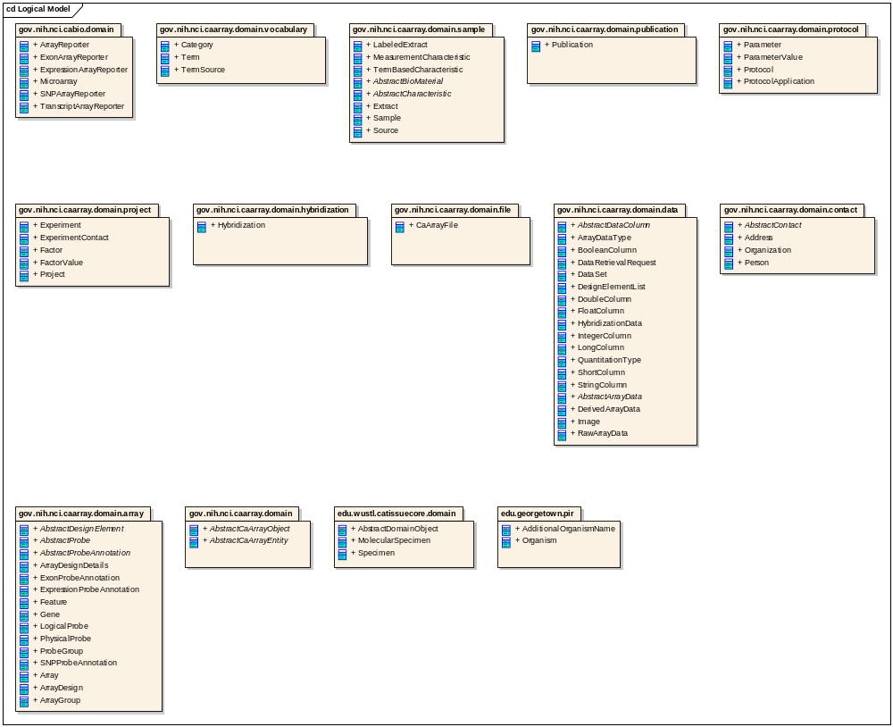
Domain Model: Packages

Slide 10
Domain Model: Microarray Data Representation Goals
Don’t require special data de-serialization or unpacking on the client
  caArray 1.x requires custom de-serializer for BioDataCube content
  It was suggested that we BASE64 encode data structure, but we decided against this or any other sort of encoding approach
Represent data in most efficient way possible for management, marshalling and serialization
Support packaging of only client-requested data
  Covered later in API discussion.

Slide 11
Domain Model: Microarray Data Approach
Array data can be conceptually represented as a spreadsheet
  QuantitationTypes are the columns (relatively few)
  AbstractDesignElements are the rows (up to 1.5M+)
Most efficient mechanism for storage and grid serialization is to store individual values as large, primitive arrays along the larger dimension.
  E.g. FloatColumn.values:float[]
  XML representation in marshalling is reasonably efficient: single XML element with space-separated numeric values
  <ns4:FloatColumn id="3" values="190.0 11263.3 164.0…” />

Slide 12
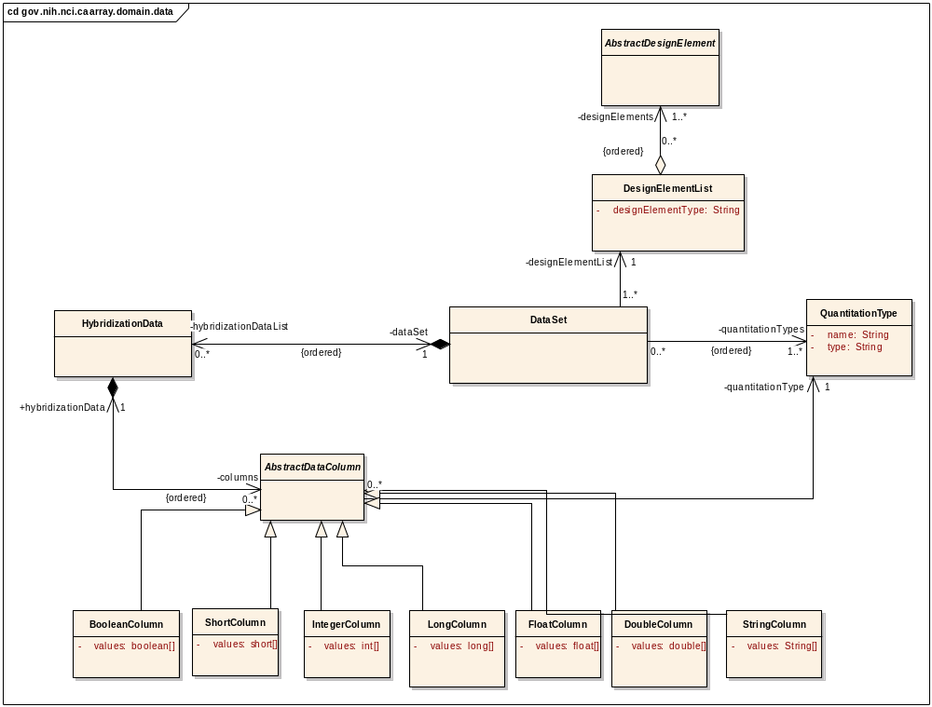
Domain Model: Microarray Data Class Diagram

Slide 13
Domain Model: Re-used classes
Model Harmonization Organism Classes
  Classes in edu.georgetown.pir
caTissue
  Specimen and MolecularSpecimen classes associated to analogous classes in gov.nih.nci.caarray.domain.sample package
caBIO
  Imported microarray reporter annotation classes and associated to analogous classes in gov.nih.nci.caarray.domain.array package

Slide 14
Architectural Overview
caArray 2.0 is a J2EE application that uses the following major technologies
  EJB 3.0
  Hibernate 3.2.0
  Struts2 2.0.9
  MySQL 5.0.27
caArray 2.0 front-end functionality is accessed via a web-based UI
Programmatic access is provided by
  EJB remote interfaces via Java RMI
  caGrid interface to same methods exposed via EJBs
caArray 2.0 is a Data Service but also exposes additional API methods for efficient data retrieval

Slide 15
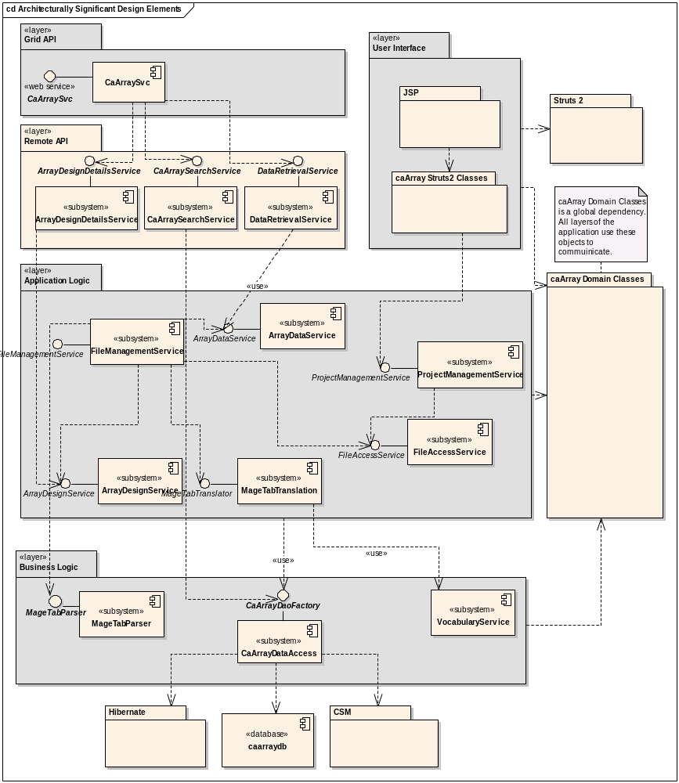
Architectural Overview: Layers and Subsystems

Slide 16
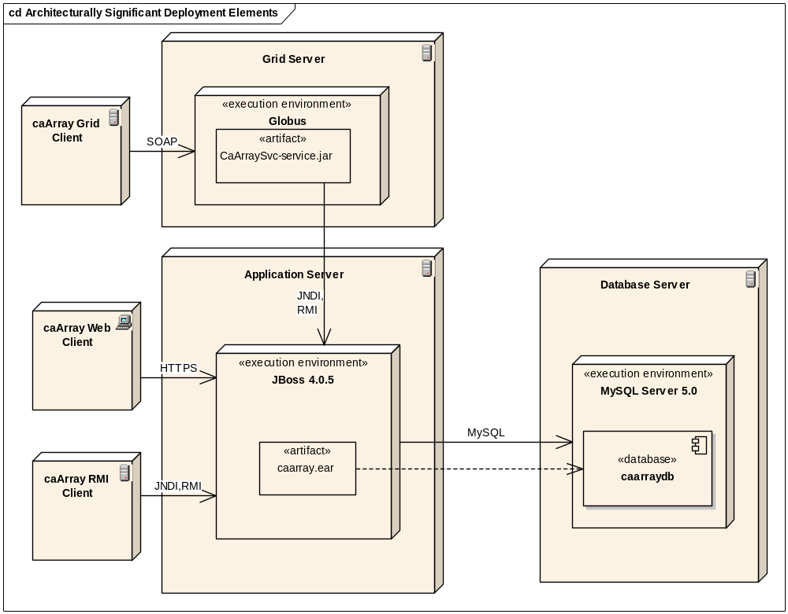
Architectural Overview: Deployment View

Slide 17
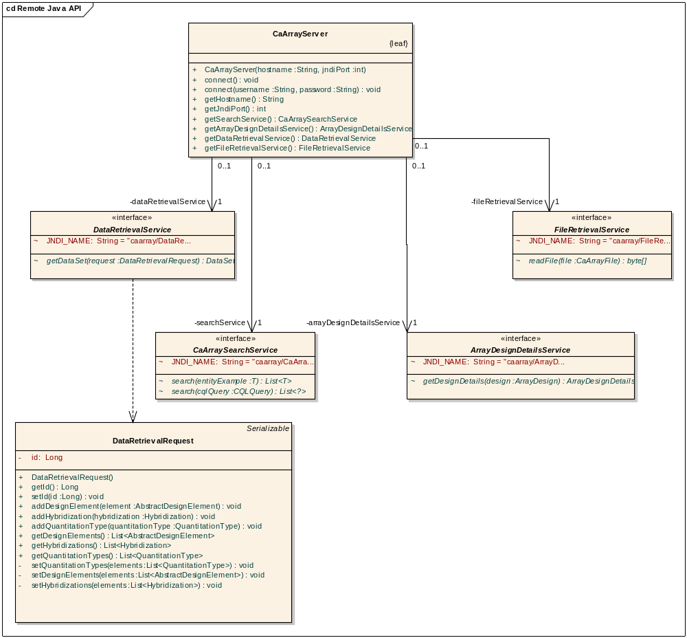
API Overview: Java API Class Diagram

Slide 18
API Overview: API Example Code
// Connect and get services
CaArrayServer server = new CaArrayServer(hostname, port);
server.connect();
CaArraySearchService searchService = server.getSearchService();
DataRetrievalService dataRetrievalService = server.getDataRetrievalService();
// CQL search example
Object target = new Object();
target.setName(QuantitationType.class.getName());
Attribute attribute = new Attribute();
attribute.setName("name");
attribute.setPredicate(Predicate.EQUAL_TO);
attribute.setValue("CELIntensity");
target.setAttribute(attribute);
CQLQuery cqlQuery = new CQLQuery();
cqlQuery.setTarget(target);
QuantitationType celIntensity = (QuantitationType) searchService.search(cqlQuery).get(0);
// Microarray data retrieval example
DataRetrievalRequest request = new DataRetrievalRequest();
request.addHybridization(lookupHybridization(searchService));
request.addQuantitationType(celIntensity);
DataSet dataSet = dataRetrievalService.getDataSet(request);

Slide 19
Architecture: Remote Java API Tests and Grid Service Tests
Remote Java APITests
  ExampleSearch
  CQLSearch
  FileDownload
  ArrayDesignDownload
  DataSetDownload
  OneFileDataSetDownload
Grid Service Tests
  GridCQLSearch
  GridFileDownload
  GridArrayDesignDownload
  GridDataSetDownload

Slide 20
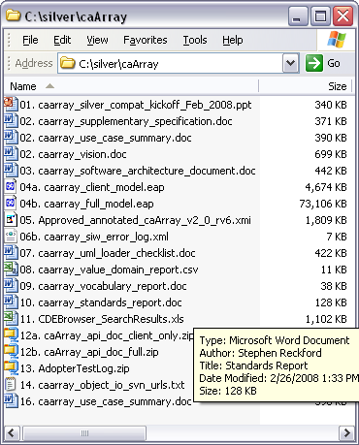
Project status
Available on GForge https://gforge.nci.nih.gov/projects/caarray2
Source and documentation available via Subversion
https://gforge.nci.nih.gov/svnroot/caarray2
Silver compatibility package available
  http://gforge.nci.nih.gov/frs/?group_id=108
  Standards relevant at time of project completion (February, 2008)
Services are exposed on the grid
http://array.nci.nih.gov/wsrf/services/cagrid/CaArraySvc

